Slide 1
Forging Process
Introduction
Forging is the process of shaping heated metal by the application of sudden blows such as unsteady pressure (hammer forging) or steady pressure (press forging) and makes use of the characteristic of the plasticity of the materials.
A metal such as steel can be shaped in a cold state, but the applications of heat lowers the yield point and makes permanent deformation easier.
Forging may be done by hand or machine.
Forging by machines involves the use of dies and is generally used in mass-production.
Forging referred to the production of the medium size and heavy parts in large scale using closed heating furnaces and heavy hammers, forging presses and machine.
Forging is the working of metal into a useful shape by hammering or pressing.
Forging is basically involving plastic deformation of material between two dies to achieve desired configuration.

Slide 2
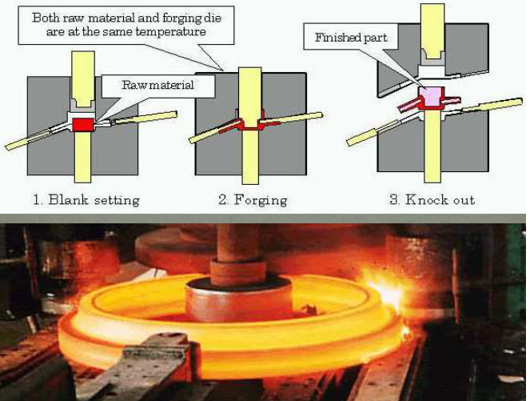

Slide 3
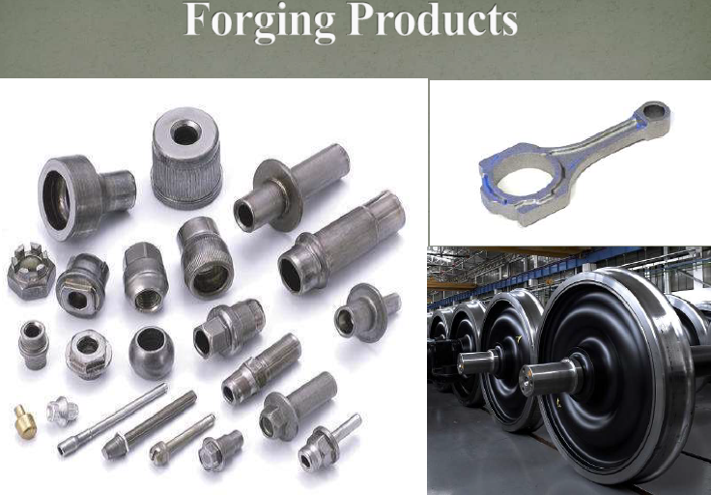

Slide 4
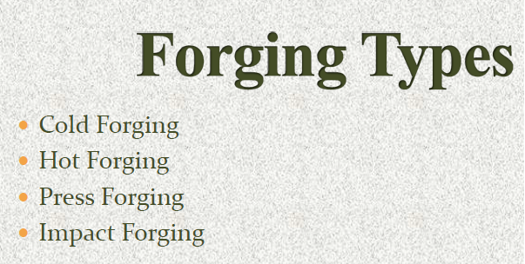
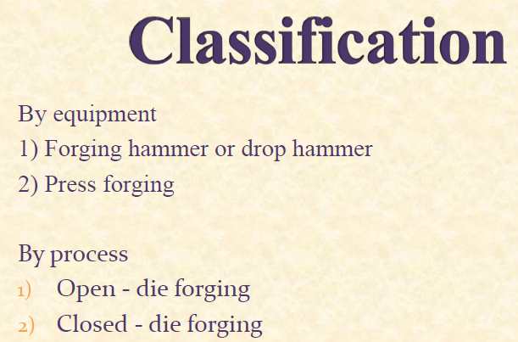

Slide 5
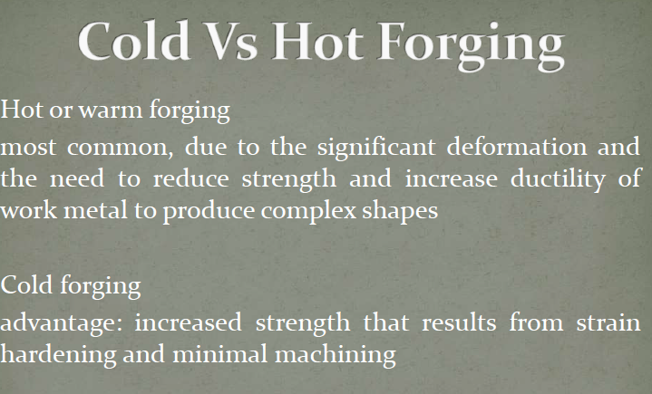

Slide 6
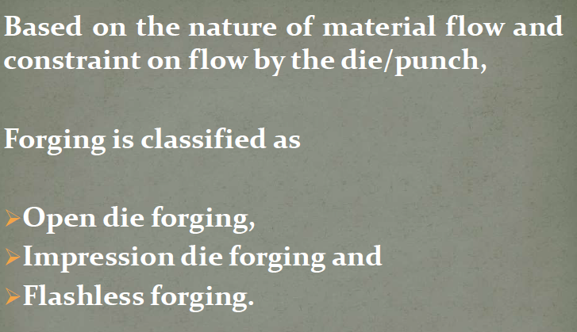

Slide 7
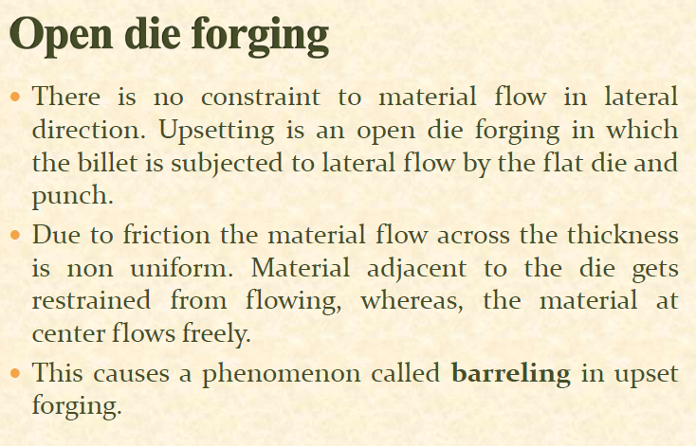

Slide 8
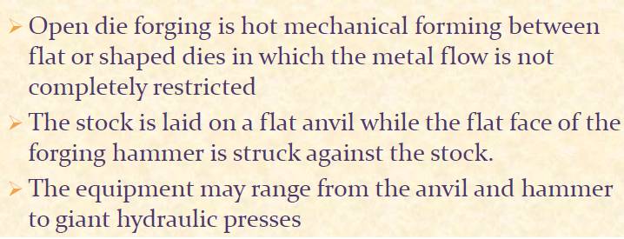

Slide 9
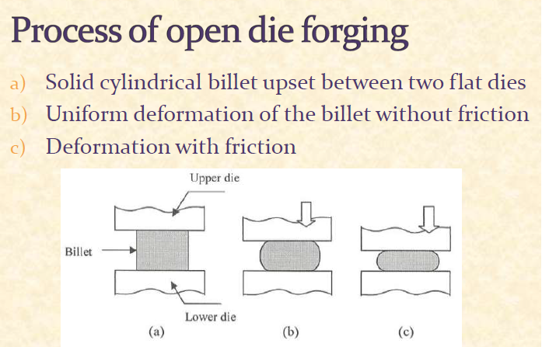

Slide 10
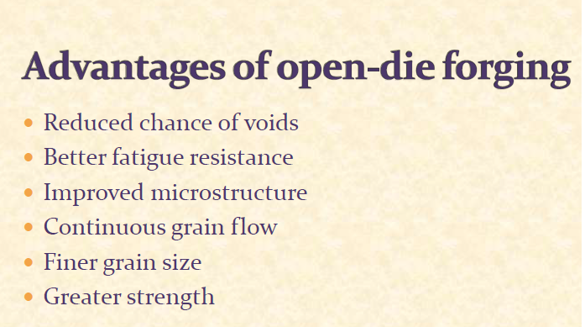

Slide 11
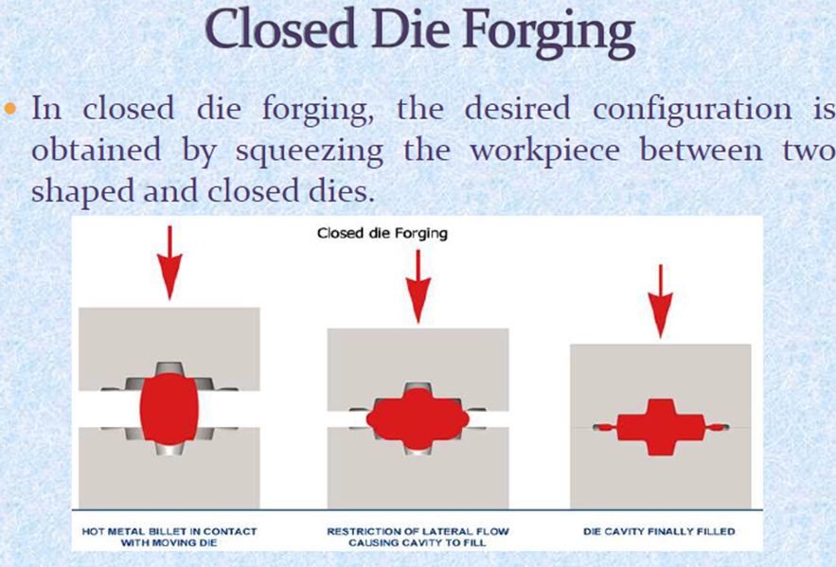

Slide 12
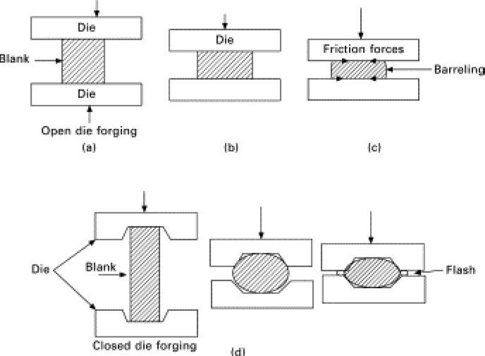

Slide 13
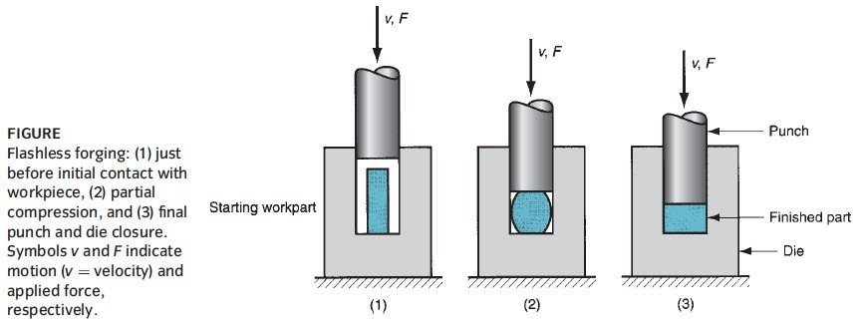
Flashless Forging
It is true closed die forging in which metal deformed in a die cavity permits virtually no excess metal to escape. During this process the preform is totally enclosed in the die cavity so that no flash is formed.
This can be easily removed by blasting and doesn’t require a trim die.
This process carried out in an elevated temperature which in between cold and hot forging.

Slide 14
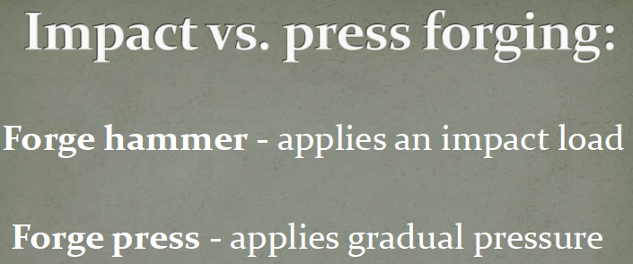

Slide 15
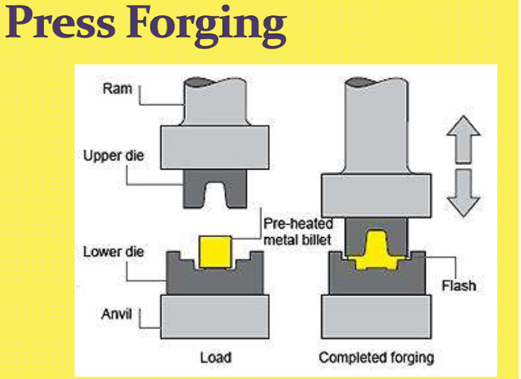

Slide 16
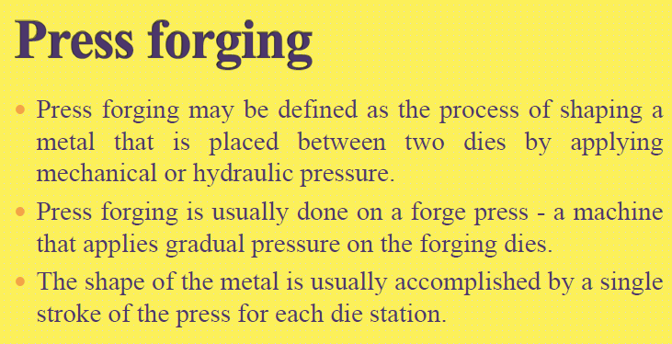

Slide 17
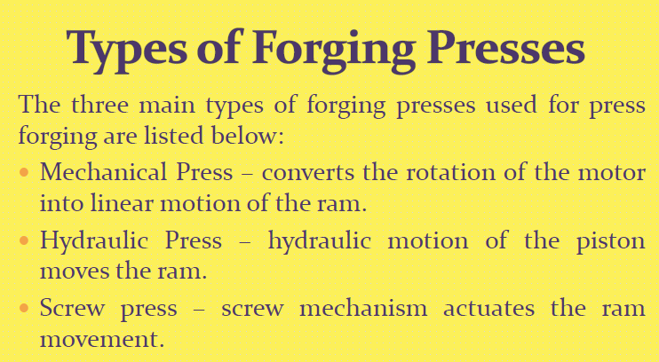

Slide 18
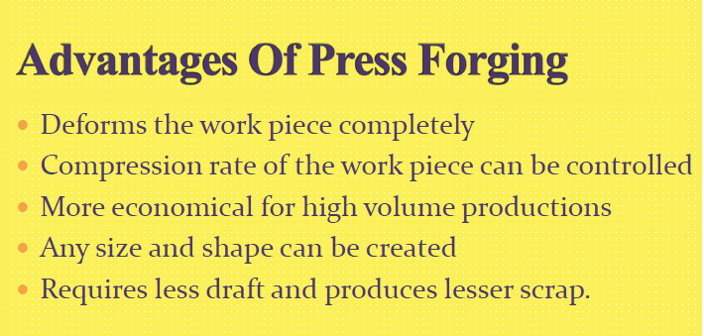

Slide 19
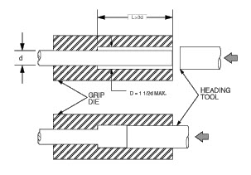
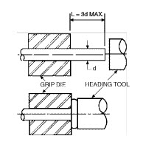
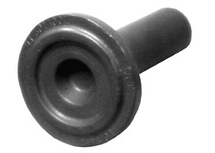
Upset Forging
Upset forging increases the diameter of the workpieces by compression its length

Slide 20
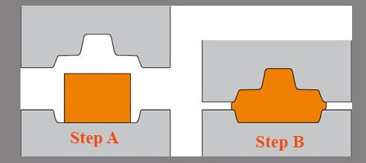
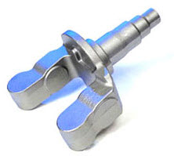
Impression-Die Forging
Compression of workpart by dies with inverse (negative impression) of desired part shape.

Slide 21
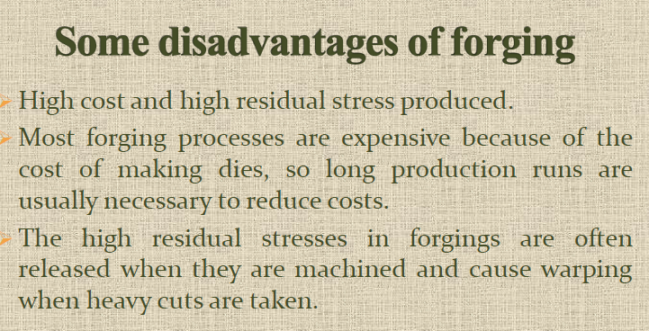

Slide 22

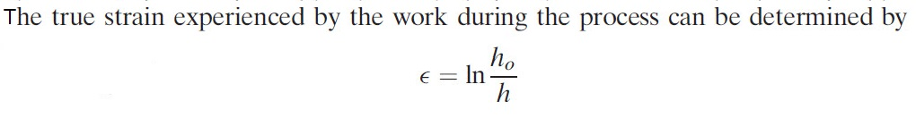
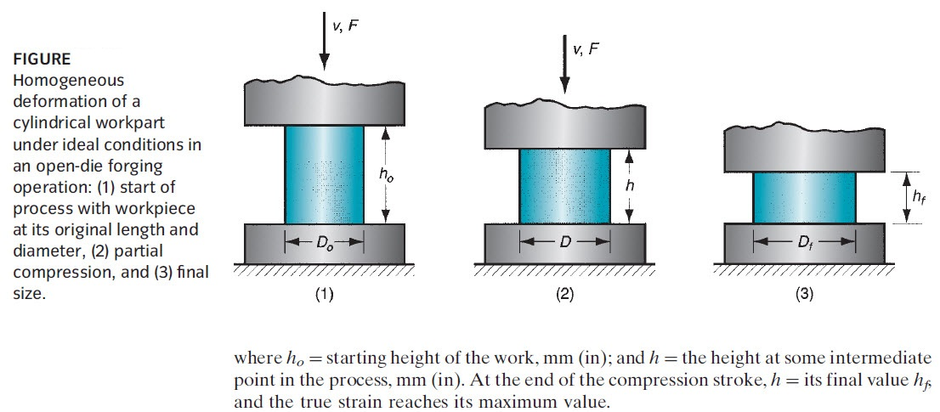

Slide 23
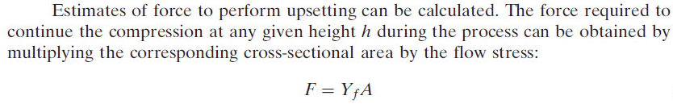
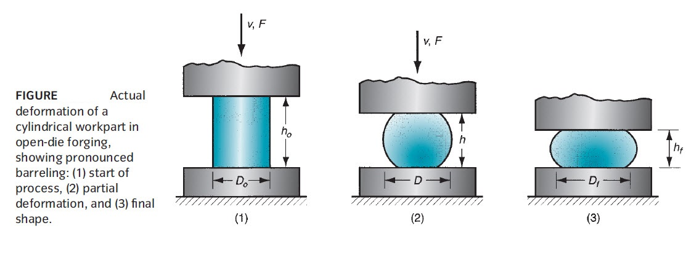
Where F= Force (N), A= Cross sectional area (${mm}^{2}),$ $Y_{f}=Flow Strss (N/{mm}^{2}$) or Mpa
$Y_{f}$ equal to the yield strength because of n equal 0 in hot working.

Slide 24
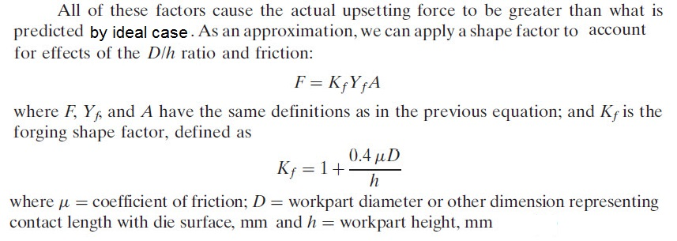
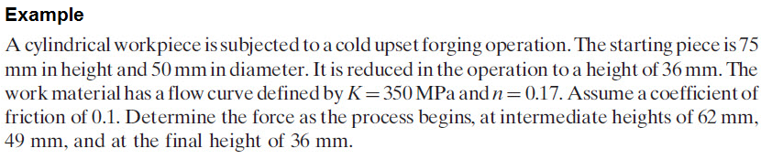
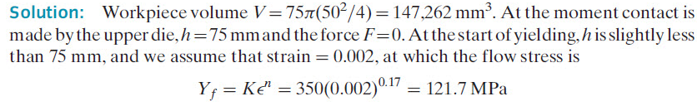

Slide 25
